Slide 1
Data Analysis for CDN Server Population Estimation with CRM Model
HSU, CHENG 許誠
Network and Systems Laboratory
Graduate Institute of Communication Engineering
National Taiwan University
Notes:
Hello Prof. Huang, Prof. Lin, Dr. Chen, and all the students.

Slide 2
Outline
Introduction
Data Analysis
Clustering
CRM Model Result
CJS with Different Data
Computation Time of CJS
Notes:
Divide into 4 parts

Slide 3
Introduction
Twitch
Capture-Recapture Model
Problem Statement
Contribution

Slide 4
Twitch
A platform hosts game streams and eSport events
Dominate the live video traffic
more than 70% of the game streaming market
Statistics (in 2021)
average concurrent viewers: 2,778,000
average concurrent streamers: 105,000
Notes:
Dominate the live video traffic (43.6% in 2014)

Slide 5
Twitch’s CDN
One-time experiment have been done (2017)
Properties
Large scale
Rapid growth
Remain large unknown to public today
Our goal is to detect CDN continuously with lower traffic
Notes:
611 thousand in 2016 to 2.78 million

Slide 6
Capture-Recapture Model (CMR)
Usually use in biology for population estimation
Population is hard to get ground truth
CRM models:
Lincoln-Petersen Model (LP model)
Cormack-Jolly-Seber model (CJS model)
CRM model with Heterogeneity

Slide 7
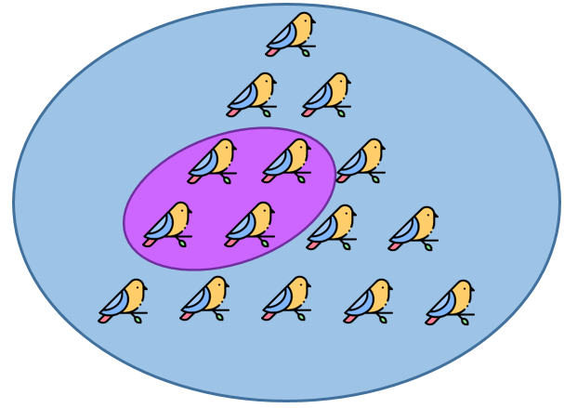
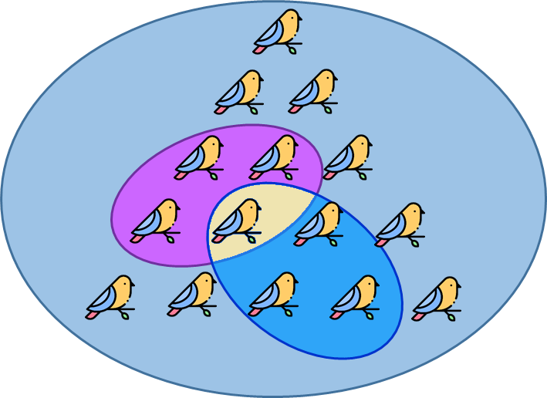
LP Model
The simplest CRM model
Steps
Capture a few animal, mark, and release
Capture again
Use the ratio of marked animal to estimate the population
Notes:
Like the birds in the image

Slide 8
CJS Model
Open population
Birth, death, move in, move out
Parameters
Time-dependent survival rate
Time-dependent capture probability
Notes:
Explain survival rate, capture p
An individual might be captured with a varying probability over time as well, i.e., the chance of an animal being captured does not need to be uniform, nor identical. The way it works is to capture and release the animals continuously. With the capturing history, it co-estimates the population, survival rate, and capturing probability at every capture, by maximum likelihood estimation (MLE)

Slide 9
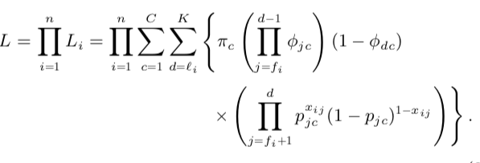
CRM Model with Heterogeneity
Allow Individual Heterogeneity
Individual from different classes has different survival rate and capture probability
Use Maximum Likelihood Estimation
p: Capture Probability
φ: Survival Rate
𝞹: Ratio of Class c
Notes:
we assume there are C classes of animals. Each class has its own time-dependent capture probability and survival rate. Each animal has a probability πc of coming from class c (sum(πc) = 1), which has the capture probability pjc and the survival rate ϕj c at j th sample.
n: the number of distinct animals caught
xij = 1 if animal i is captured on occasion j
pjc: probability of capture in sample j
φjc: probability of survival to the next sample
fi: animal i is first captured in sample fi, last in li , departure time di(unknown)
CHi: animal i captured history

Slide 10
Problem Statement
Previous work:
Use the CJS model to estimate servers population
In the CJS model, all servers share the same time-dependent survival rate and capture probability
However, the different servers may have different survival rates and capture probabilities.
Notes:
In our previous work, we successfully use CJS model to estimate population.

Slide 11
Problem Statement
Most general model:
Each servers has its own time-dependent survival rate and capture probability
Disadvantage:
High computation overhead
Solution:
Use clustering on servers to lower computation overhead of the CRM model with heterogeneity.
Notes:
In our previous work, we successfully use CJS model to estimate population.

Slide 12
Problem Statement
Improve the CDN servers estimation model by using data analysis to find a clustering way for the CRM model with heterogeneity
Notes:
In our previous work, we successfully use CJS model to estimate population.

Slide 13
Co-work with Wung Wei-Shiang
Preparing
Server Clustering
Server Number Estimation with MLE-CJS
Data Analysis
(Regions,
Server Patterns)
Frequency of Occurrence and
IP subnets
Offline/online Estimation with No Clustering
K-means: Transactions in Different Days
Study The Theory of MLE-based CJS with Heterogeneity
Clustering-based Estimation with MLE-CJS Model
K-means: Transactions in Three Time Periods

Slide 14
Contribution
Study the theory of CRM model with heterogeneity
Divide the Twitch’s CDN servers into several groups by transaction counts in different periods for the CRM model with heterogeneity
Survey the relationship between clustering results and the CRM model performance.

Slide 15
Data Analysis
Dataset Introduction
Data in Different Regions
Continuous Data
Hour-Count Distribution

Slide 16
Dateset Introduction
Collected by Caleb Wang in 2021 April ~ 2021 May
Goal: choose top K channels that account for 80% of total viewers
Result: Wang selected VPN servers in 18 different countries that contain about 75% traffic on Twitch.

Slide 17
Dateset Introduction
Data Structure
[‘_id’, ‘vpnServerId’, ‘channel’, ‘language’, ‘serverPool’, ‘start’, ‘end’, ‘transactionList’, ‘addrPool’]
‘transactionList’: This attribute is the record of probing. It contains a list of times and the corresponding server ips.
e.g. {‘2020-10-19T14:56:08’: ‘52.223.247.211’, ‘2020-10- 19T15:02:04’: ‘45.113.128.160’}
Notes:
For each data, it represent the crawler keep probing to one channel

Slide 18
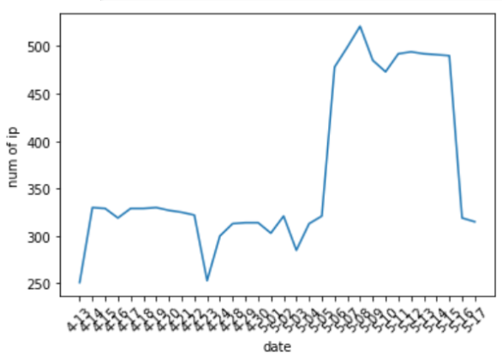
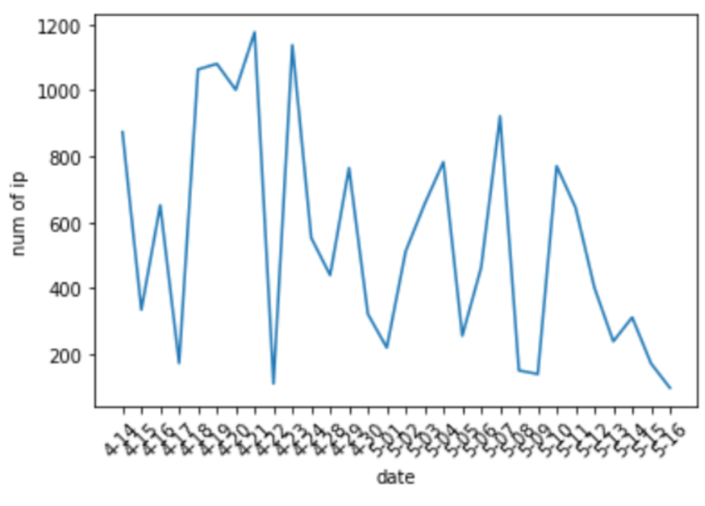
Date in Different Regions
United States
United Kingdom
Notes:
Why Choose Us data
Stable -> 24 hour collect

Slide 19
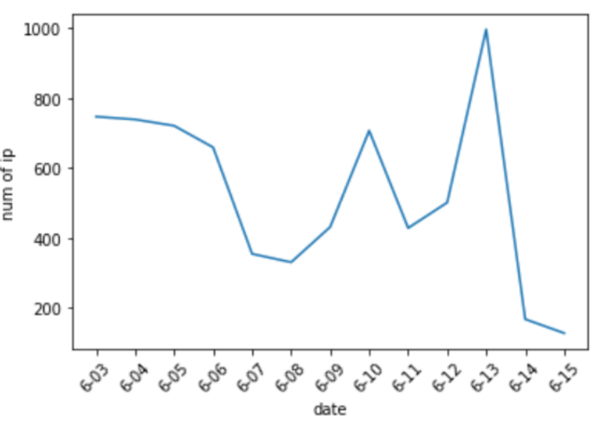
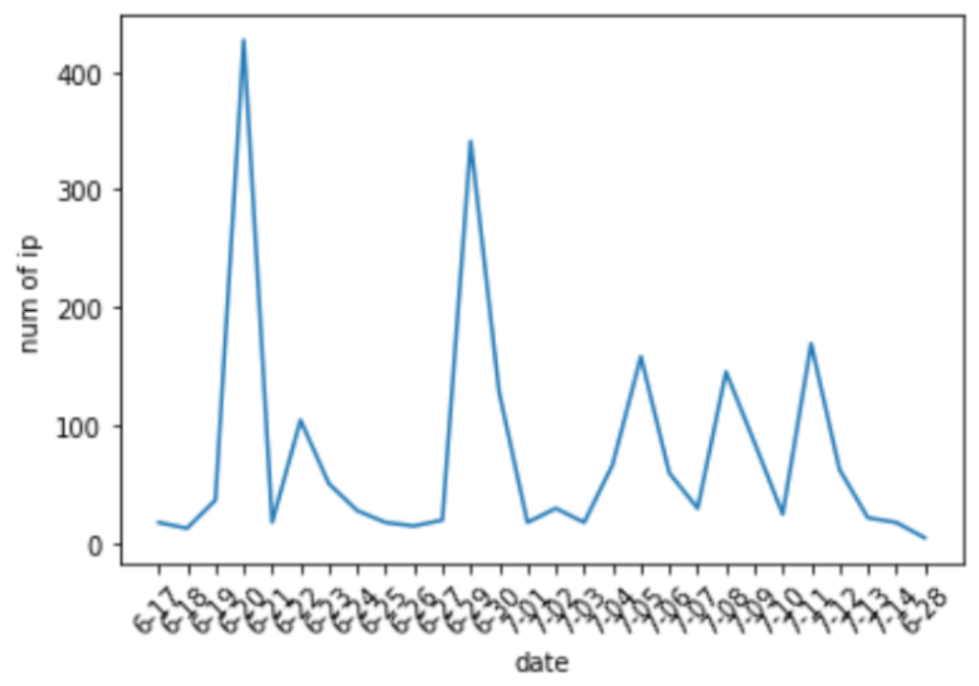
Date in Different Regions
France
Netherlands

Slide 20
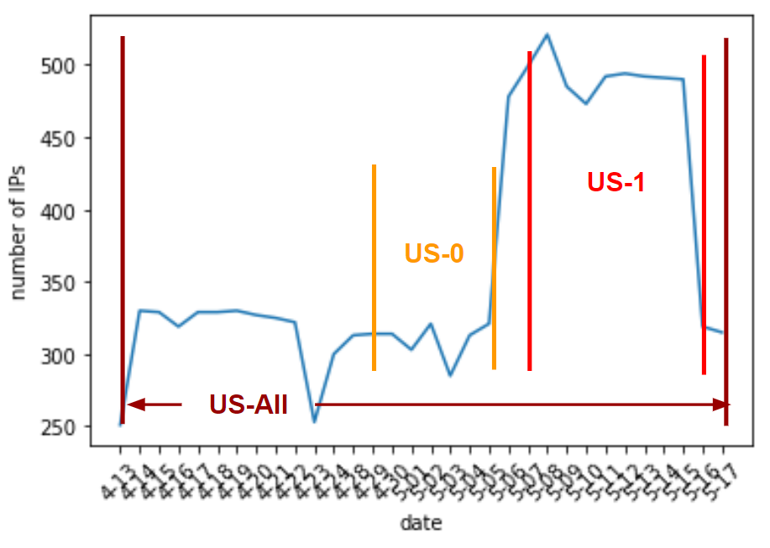
Continuous Data
Definition: the crawler functioned 24 hours for more than 7 continuous days

Slide 21
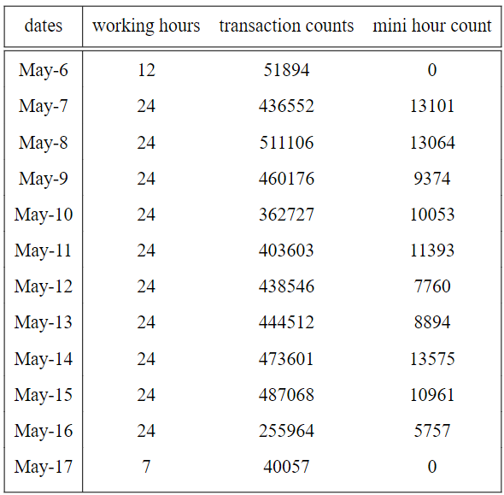
Continuous Data – US-1
Period:
May 7 ~ May 16
In US-1, the crawler collected the data for 24 hours for 10 continuous days.
I use the data, US-1, to do the following experiments.

Slide 22
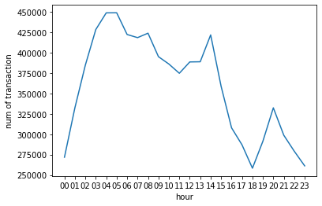
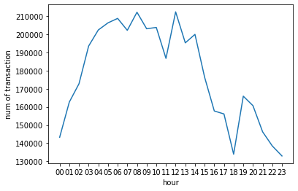
Hour-Count Distribution
Hour-Count Distribution in different periods
US-All
Us-1

Slide 23
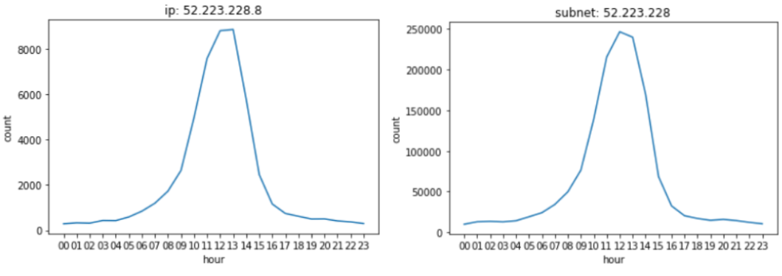
Hour-Count Distribution
Hour-Count Distribution in same subnet (24bit)
Notes:
For this example

Slide 24
Clustering
Attributes Selection
Clustering Method
Clustering Results Evaluation

Slide 25
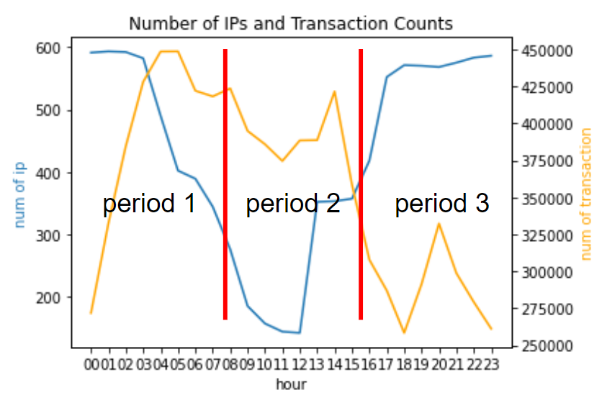
Attributes Selection
Use transaction counts (orange line) in 3 periods to be attributes for clustering

Slide 26
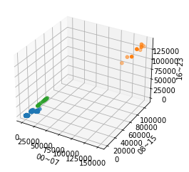
Clustering Method
Clustering Algorithm:
Mini-Batch K-Means
Number of Clusters: 3
Notes:
Explain the axis. Transaction count in 00~07，

Slide 27
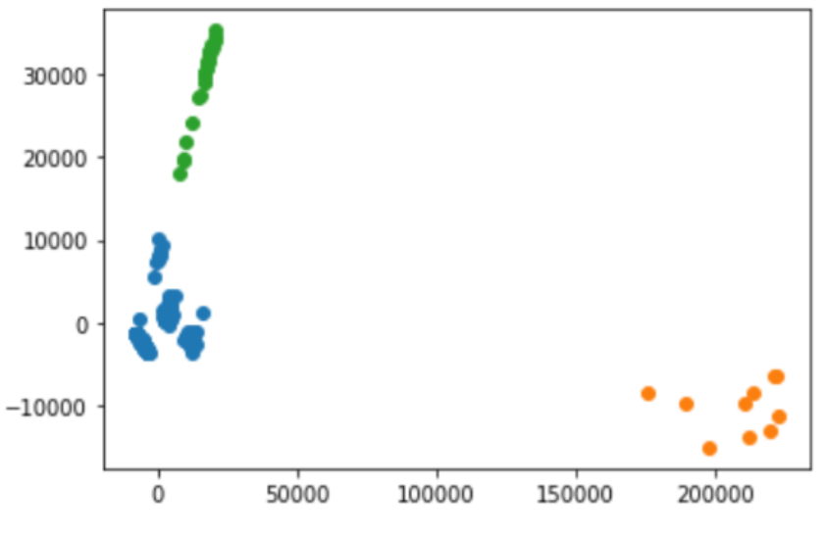
Clustering Method
Dimension Reduction:
PCA
Dimension: 3 -> 2

Slide 28
Clustering Results Evaluation
S_Dbw score
Internal evaluation: no ground truth
Consider both inter-cluster density (Dens_bw) and intra-cluster variance (Scat)
Lower value represents better performance
S_Dbw (c) = Scat(c) + Dens_bw(c)

Slide 29
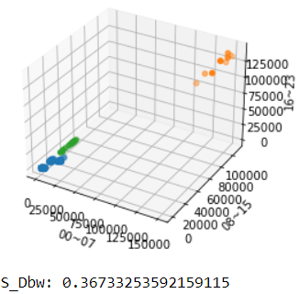
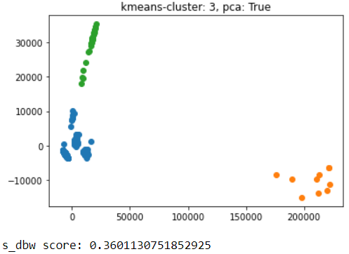
Clustering Results Evaluation
Result with and without dimension reduction
Data: US-All
Without PCA
With PCA

Slide 30
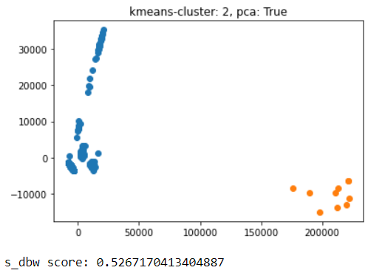
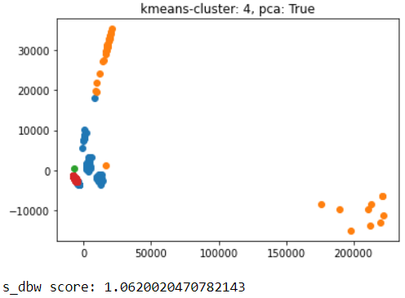
Clustering Results Evaluation
K-means with different numbers of clusters
Data: US-All

Slide 31
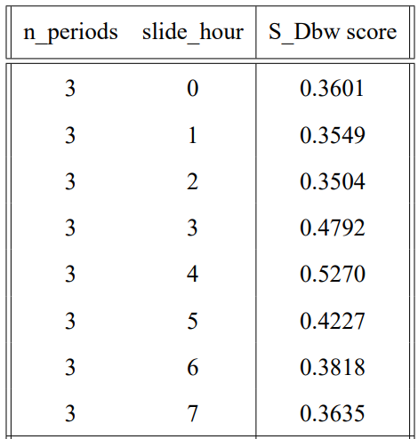
Clustering Results Evaluation
Data: US-All
Number of Clusters = 3
Number of Periods = 3
Example:
n_periods: 3, slide_hour:2
Transaction count in
[02~09, 10~17, 18~01]

Slide 32
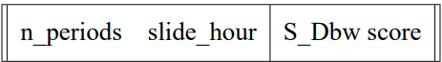
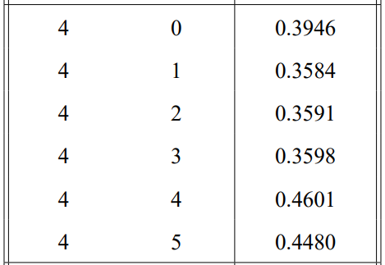
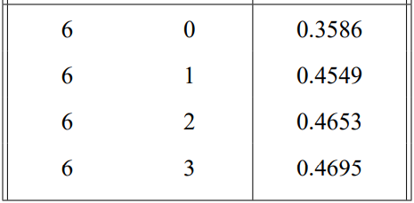
Clustering Results Evaluation
Number of Periods = 4
Number of Periods = 6

Slide 33
Clustering Results Evaluation
After I check all the clustering results, I find that the results with S_Dbw score less than 0.37 are actually the same as each other.
They have the same servers’ distribution of 3 clusters. I choose one result to apply in Preliminaries

Slide 34
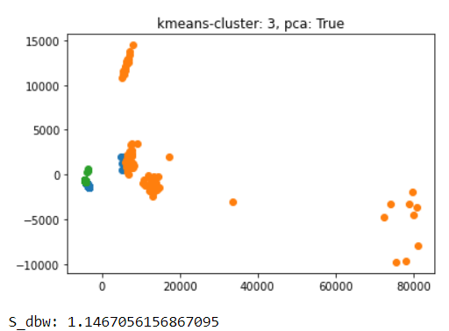
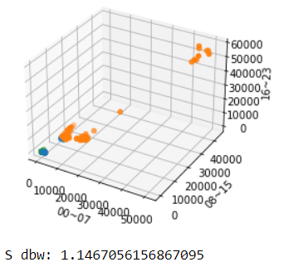
Clustering Results Evaluation
K-means with US-1 data
Notes:
Blue class overlap with orange class and green class

Slide 35
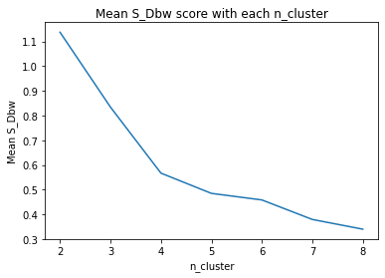
Clustering Results Evaluation
Run Mini-Batch K-Means 10 times for each n_cluster
Notes:
Without a fixed random seed in k-means

Slide 36
Clustering Results Evaluation
Alternative Metric
For each cluster
Std/Avg: Standard Deviation/Average Number Std and Avg are calculated by sample number on each date
Cluster Size: the number of IPs in one cluster
For each clustering result (contains n cluster)
Mean Std/Avg: mean Std/Avg of all the cluster in one clustering result
Min Cluster Size: the minimum cluster size in one clustering result

Slide 37
CRM Model result
Preliminaries
CJS Model Analysis – K-Means
CJS Model Analysis – Random Clustering

Slide 38
Preliminaries
Error rate = |baseline – estimation| /baseline * 100%
Baseline: number of servers observed in one day (24 hours)

Slide 39
Preliminaries
Error Rate in the CJS model on US-1 (sample at 12am)
No clustering: 0.82%
K-Means (3 clusters): 1.92% * Use the clustering result with US-All

Slide 40
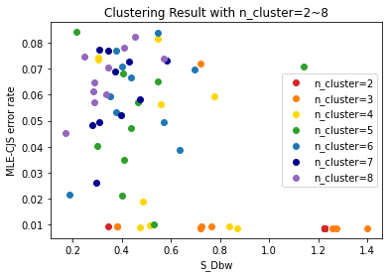
CJS Model Analysis – K-Means
The scatter plot for S_Dbw score and Error Rate of MLE-CJS (US-1)

Slide 41
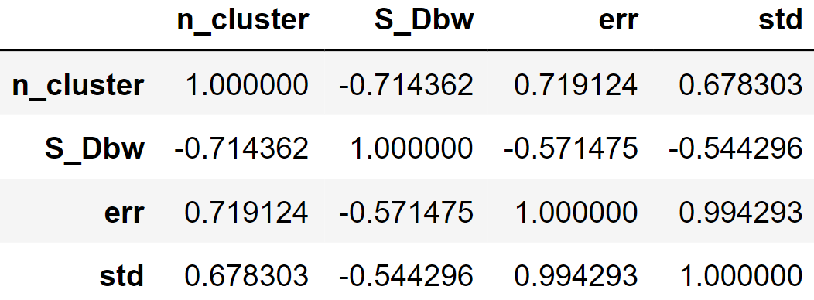
CJS Model Analysis – K-Means
Correlation Matrix

Slide 42
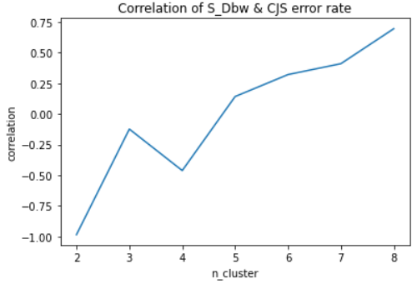
CJS Model Analysis – K-Means
Correlation of S_Dbw & Error Rate with different n_cluster

Slide 43
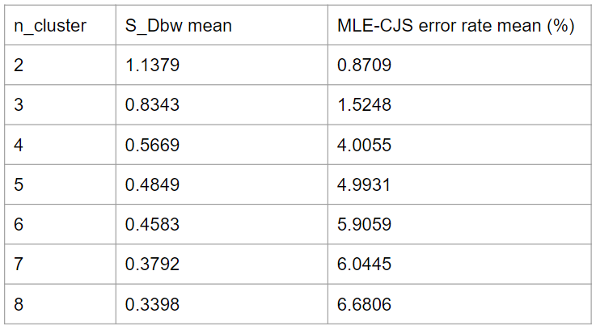
CJS Model Analysis – K-Means
Mean of S_Dbw and Error Rate

Slide 44
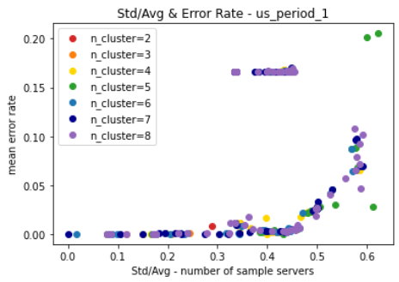
CJS Model Analysis – K-Means
The scatter plot of Std/Avg & Cluster Error Rate (for each cluster)

Slide 45
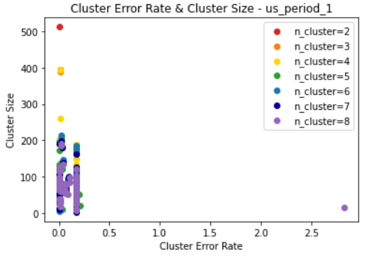
CJS Model Analysis – K-Means
The scatter plot of Cluster Size & Cluster Error Rate (for each cluster)

Slide 46
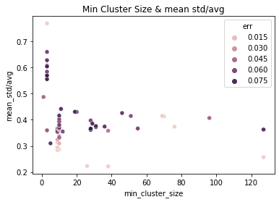
CJS Model Analysis – K-Means
The scatter plot of Min Cluster Size & Mean Std/Avg & Error Rate (for each clustering result)

Slide 47
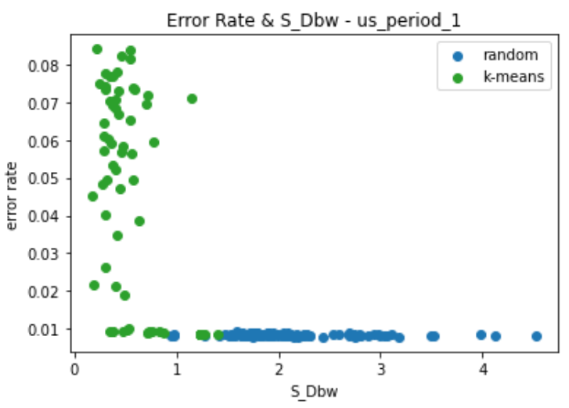
CJS Model Analysis – Random Clustering
To be the control group, I randomly divide IPs into n clusters with similar size 20 times for each n_cluster

Slide 48
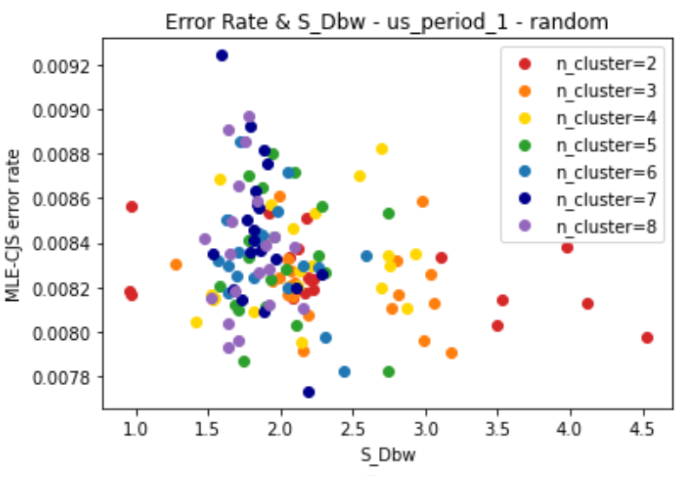
CJS Model Analysis – Random Clustering
The scatter plot of Error Rate & S_Dbw (for each clustering result)

Slide 49
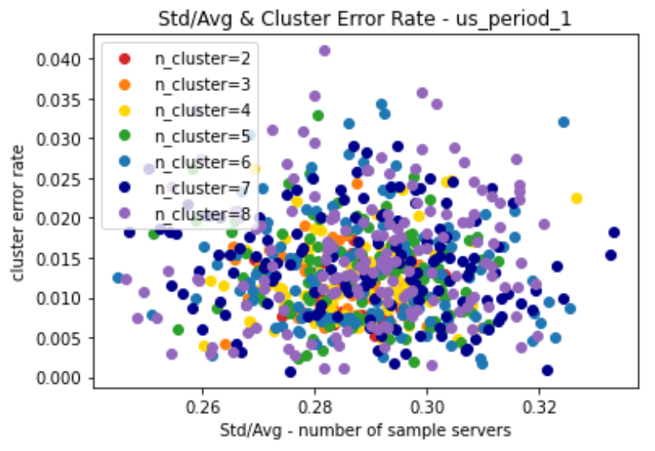
CJS Model Analysis – Random Clustering
The scatter plot of Std/Avg & Cluster Error Rate (for each cluster)

Slide 50
CJS with Different Data
US - 0
The UK
France
The Netherlands
Germany

Slide 51
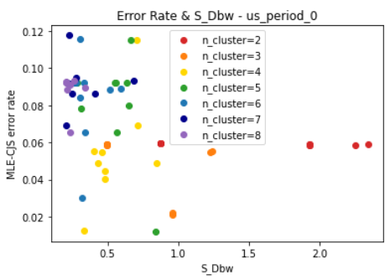
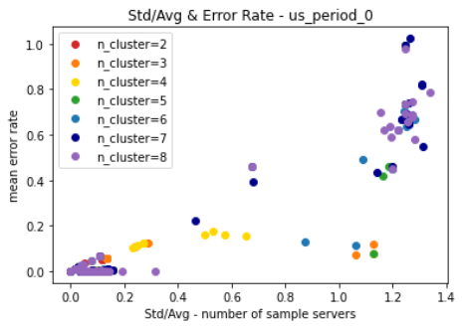
US-0 (April 29 to May 05)
K-Means Clustering
S_Dbw & Error Rate
Std/Avg & Cluster Error Rate

Slide 52
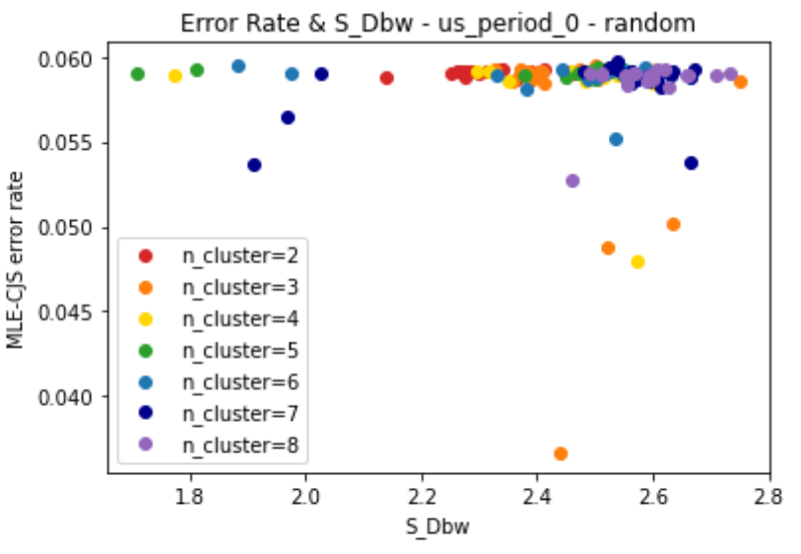
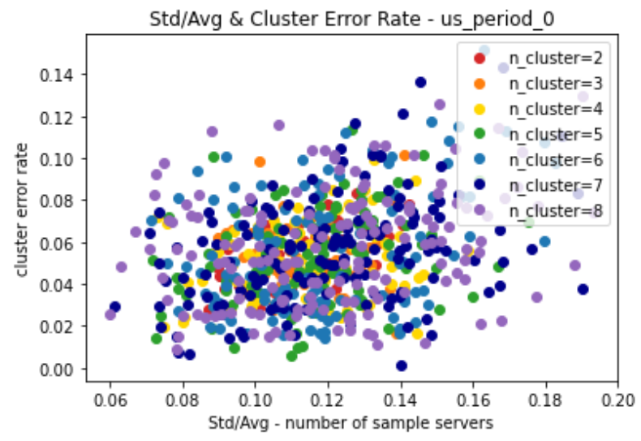
US-0 (April 29 to May 05)
Random Clustering
S_Dbw & Error Rate
Std/Avg & Cluster Error Rate

Slide 53
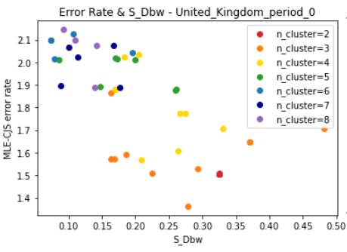
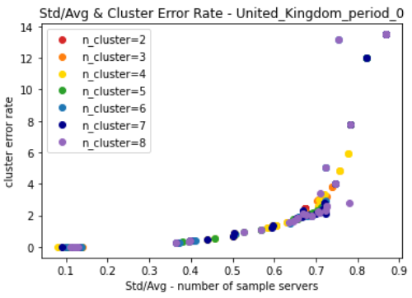
UK-0 (April 29 to May 05)
K-Means Clustering
S_Dbw & Error Rate
Std/Avg & Cluster Error Rate

Slide 54
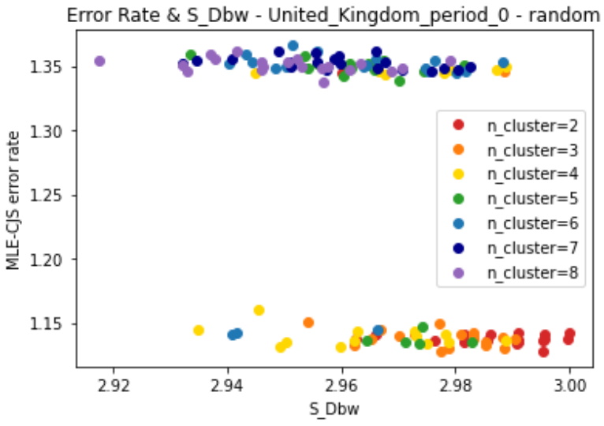
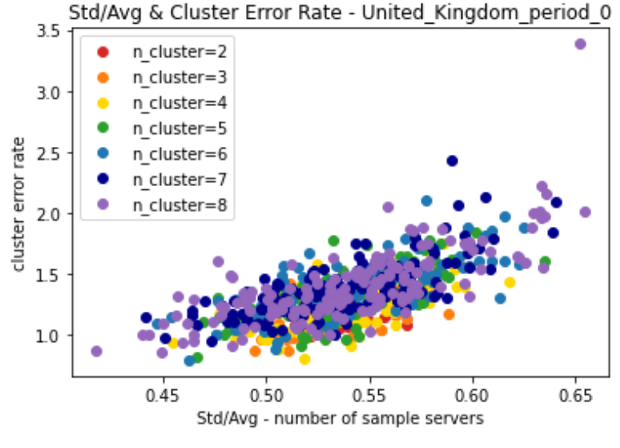
UK-0 (April 29 to May 05)
Random Clustering
S_Dbw & Error Rate
Std/Avg & Cluster Error Rate

Slide 55
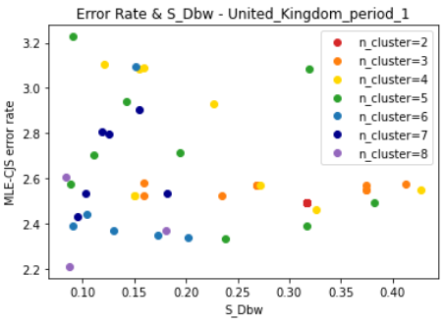
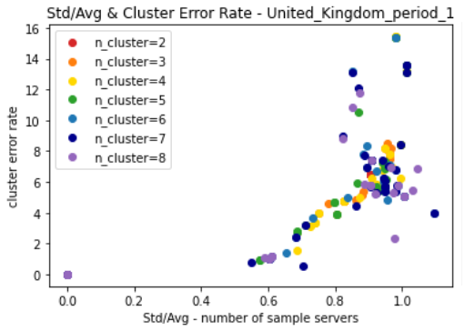
UK-1 (May 07 to May 15)
K-Means Clustering
S_Dbw & Error Rate
Std/Avg & Cluster Error Rate

Slide 56
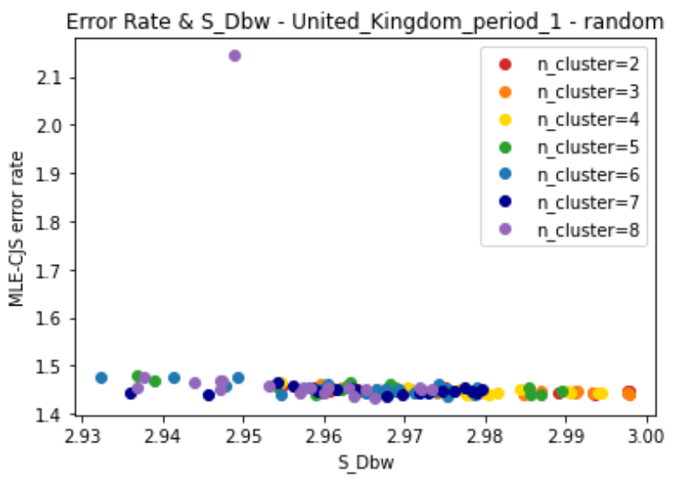
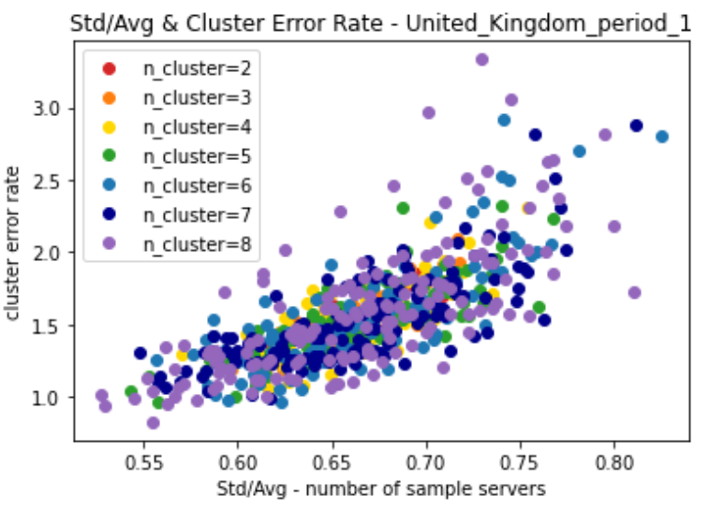
UK-1 (May 07 to May 15)
Random Clustering
S_Dbw & Error Rate
Std/Avg & Cluster Error Rate

Slide 57
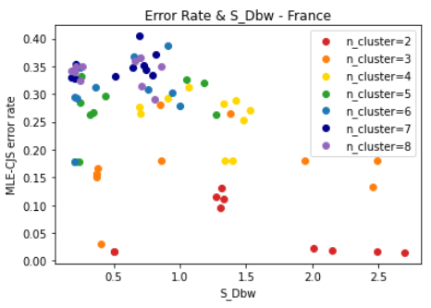
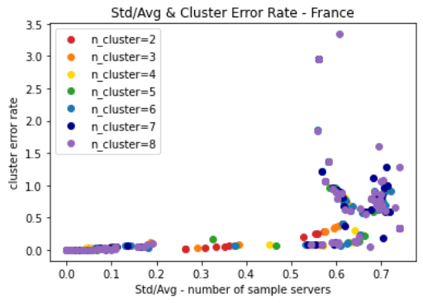
France (April 29 to May 05)
K-Means Clustering
S_Dbw & Error Rate
Std/Avg & Cluster Error Rate

Slide 58


France (April 29 to May 05)
Random Clustering
S_Dbw & Error Rate
Std/Avg & Cluster Error Rate

Slide 59

Netherlands-0 (June 18 to June 27)
K-Means Clustering
S_Dbw & Error Rate

Slide 60


Netherlands-0 (June 18 to June 27)
Random Clustering
S_Dbw & Error Rate
Std/Avg & Cluster Error Rate

Slide 61

Netherlands-1 (June 30 to July 13)
K-Means Clustering
S_Dbw & Error Rate

Slide 62


Netherlands-1 (June 30 to July 13)
Random Clustering
S_Dbw & Error Rate
Std/Avg & Cluster Error Rate

Slide 63


Germany (June 04 to June 14)
K-Means Clustering
S_Dbw & Error Rate
Std/Avg & Cluster Error Rate

Slide 64


Germany (June 04 to June 14)
Random Clustering
S_Dbw & Error Rate
Std/Avg & Cluster Error Rate

Slide 65
Computation Time of CJS
Computation Time in the US
Computation Time in Different Region

Slide 66

Computation Time in the US
Computation Time & Number of Clusters

Slide 67

Computation Time in Different Region
The Correlations between n_cluster & computation time are all close to 1.
As the number of clusters gets larger, the computation time of the CJS will tend to have a linear growth.

Slide 68
Conclusion
The goal of this research is to build the CRM model with heterogeneity for CDN servers population estimation.
CDN servers from same subnet (24bit) has similar hour and transaction count distribution.
S_Dbw is not a good metric for the CRM model. Instead, Std/Avg could be a good metric for predicting the performance of the CRM model.
Computation time is close to have a linear relationship with number of clusters.

Slide 69
Q&A

